Slide 1
I/O Systems Lesson 1 Introduction
David Liu
Fall 2021

Slide 2
Learning Outcomes
Explore the structure of an operating system’s I/O subsystem
Discuss the principles and complexities of I/O hardware
Explain the performance aspects of I/O hardware and software

Slide 3
I/O Hardware
Incredible variety of I/O devices
Storage
Transmission
Human-interface

Slide 4
I/O Hardware Common concepts
Signals from I/O devices interface with computer
Port – connection point for device
Bus - daisy chain or shared direct access
PCI bus common in PCs and servers, PCI Express (PCIe)
expansion bus connects relatively slow devices
Serial-attached SCSI (SAS) common disk interface
Controller (host adapter) – electronics that operate port, bus, device
Sometimes integrated
Sometimes separate circuit board (host adapter)
Contains processor, microcode, private memory, bus controller, etc
Some talk to per-device controller with bus controller, microcode, memory, etc

Slide 5
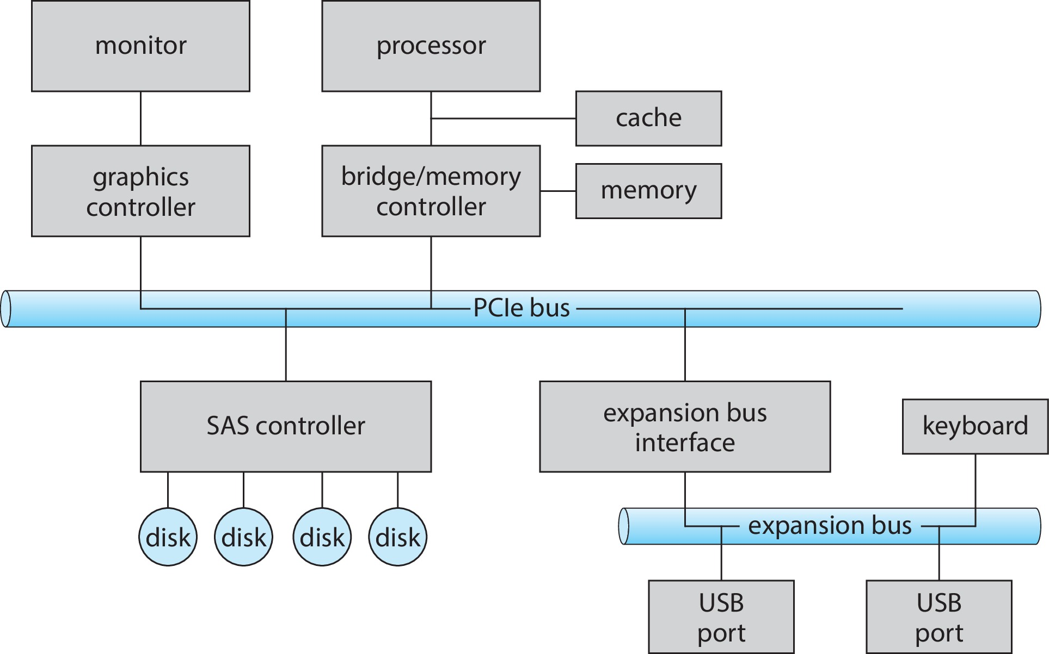
A Typical PC Bus Structure

Slide 6
I/O Hardware (Cont.)
Fibre channel (FC) is complex controller, usually separate circuit board (host-bus adapter (HBA)) plugging into bus
I/O instructions control devices
Devices usually have registers where device driver places commands, addresses, and data to write, or read data from registers after command execution
Data-in register, data-out register, status register, control register
Typically 1-4 bytes, or FIFO buffer
Devices have addresses

Slide 7
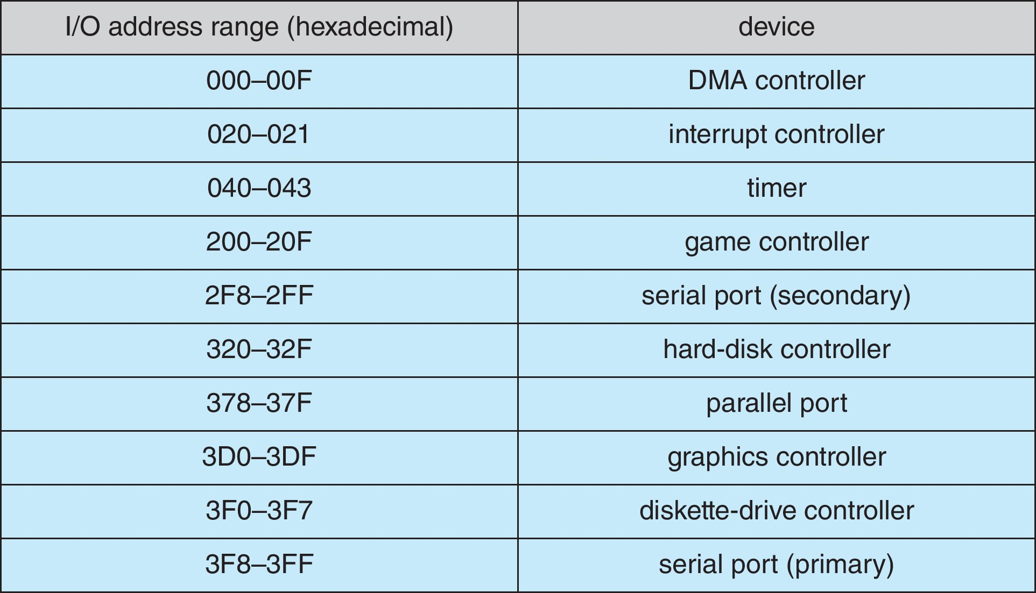
Device I/O Port Locations on PCs (partial)

Slide 8
I/O Hardware Device Control
Special I/O instructions
Memory-mapped I/O
Device data and command registers mapped to processor address space
Especially for large address spaces (graphics)
Now commonly memory-mapped I/O

Slide 9
Polling
For each byte of I/O
(host) Read busy bit from status register until busy bit is 0
Host sets read or write bit and if write copies data into data-out register
Host sets command-ready bit
Controller sets busy bit, executes transfer
Controller clears busy bit, error bit, command-ready bit when transfer done
Step 1 is busy-wait cycle to wait for I/O from device
Reasonable if device is fast
But inefficient if device slow
CPU switches to other tasks?
But if miss a cycle data overwritten / lost
e.g. small buffer when streaming data)

Slide 10
Interrupts
Polling can happen in 3 instruction cycles
Read status, logical-and to extract status bit, branch if not zero
How to be more efficient if non-zero infrequently?
CPU Interrupt-request line triggered by I/O device
Checked by processor after each instruction
Interrupt handler receives interrupts
Maskable to ignore or delay some interrupts
Interrupt vector to dispatch interrupt to correct handler
Context switch at start and end
Based on priority
Some nonmaskable
Interrupt chaining if more than one device at same interrupt number

Slide 11
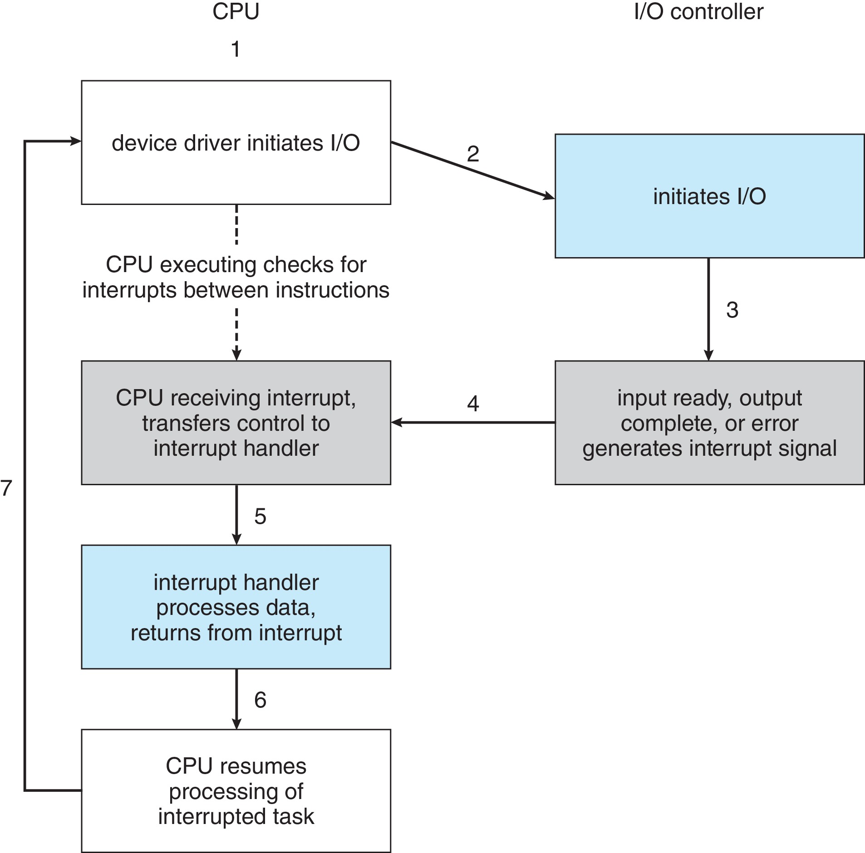
Interrupt-Driven I/O Cycle

Slide 12
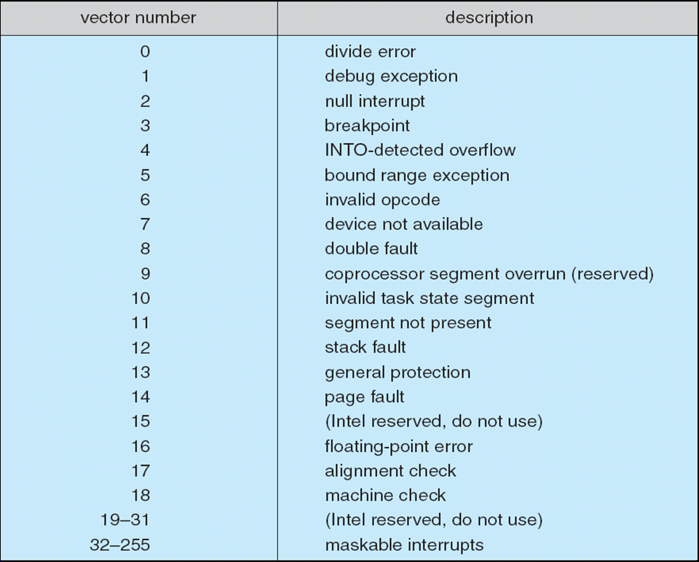
Intel Pentium Processor Event-Vector Table

Slide 13
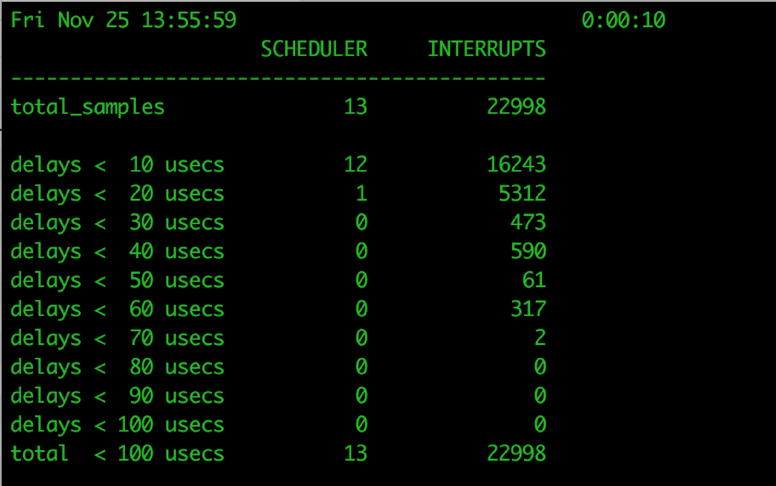
Interrupt Numbers
Stressing interrupt management because even single-user systems
manage hundreds or interrupts per sec
servers hundreds of thousands per sec
For example, a quiet macOS desktop generated 23,000 interrupts over 10 seconds

Slide 14
Interrupts Mechanism for Other Usage
Interrupt mechanism also used for exceptions
Terminate process, crash system due to hardware error
Page fault executes when memory access error
System call executes via trap to trigger kernel to execute request
Multi-CPU systems can process interrupts concurrently
If operating system designed to handle it
Used for time-sensitive processing, frequent, must be fast

Slide 15
Direct Memory Access
Used to avoid programmed I/O (one byte at a time) for large data movement
Offload from CPU to DMA controller
Bypasses CPU to transfer data directly between I/O device and memory
OS writes DMA command block into memory
Source and destination addresses
Read or write mode
Count of bytes
Writes location of command block to DMA controller
Bus mastering of DMA controller – grabs bus from CPU
Cycle stealing from CPU but still much more efficient
When done, interrupts to signal completion
Version that is aware of virtual addresses can be even more efficient - DVMA

Slide 16
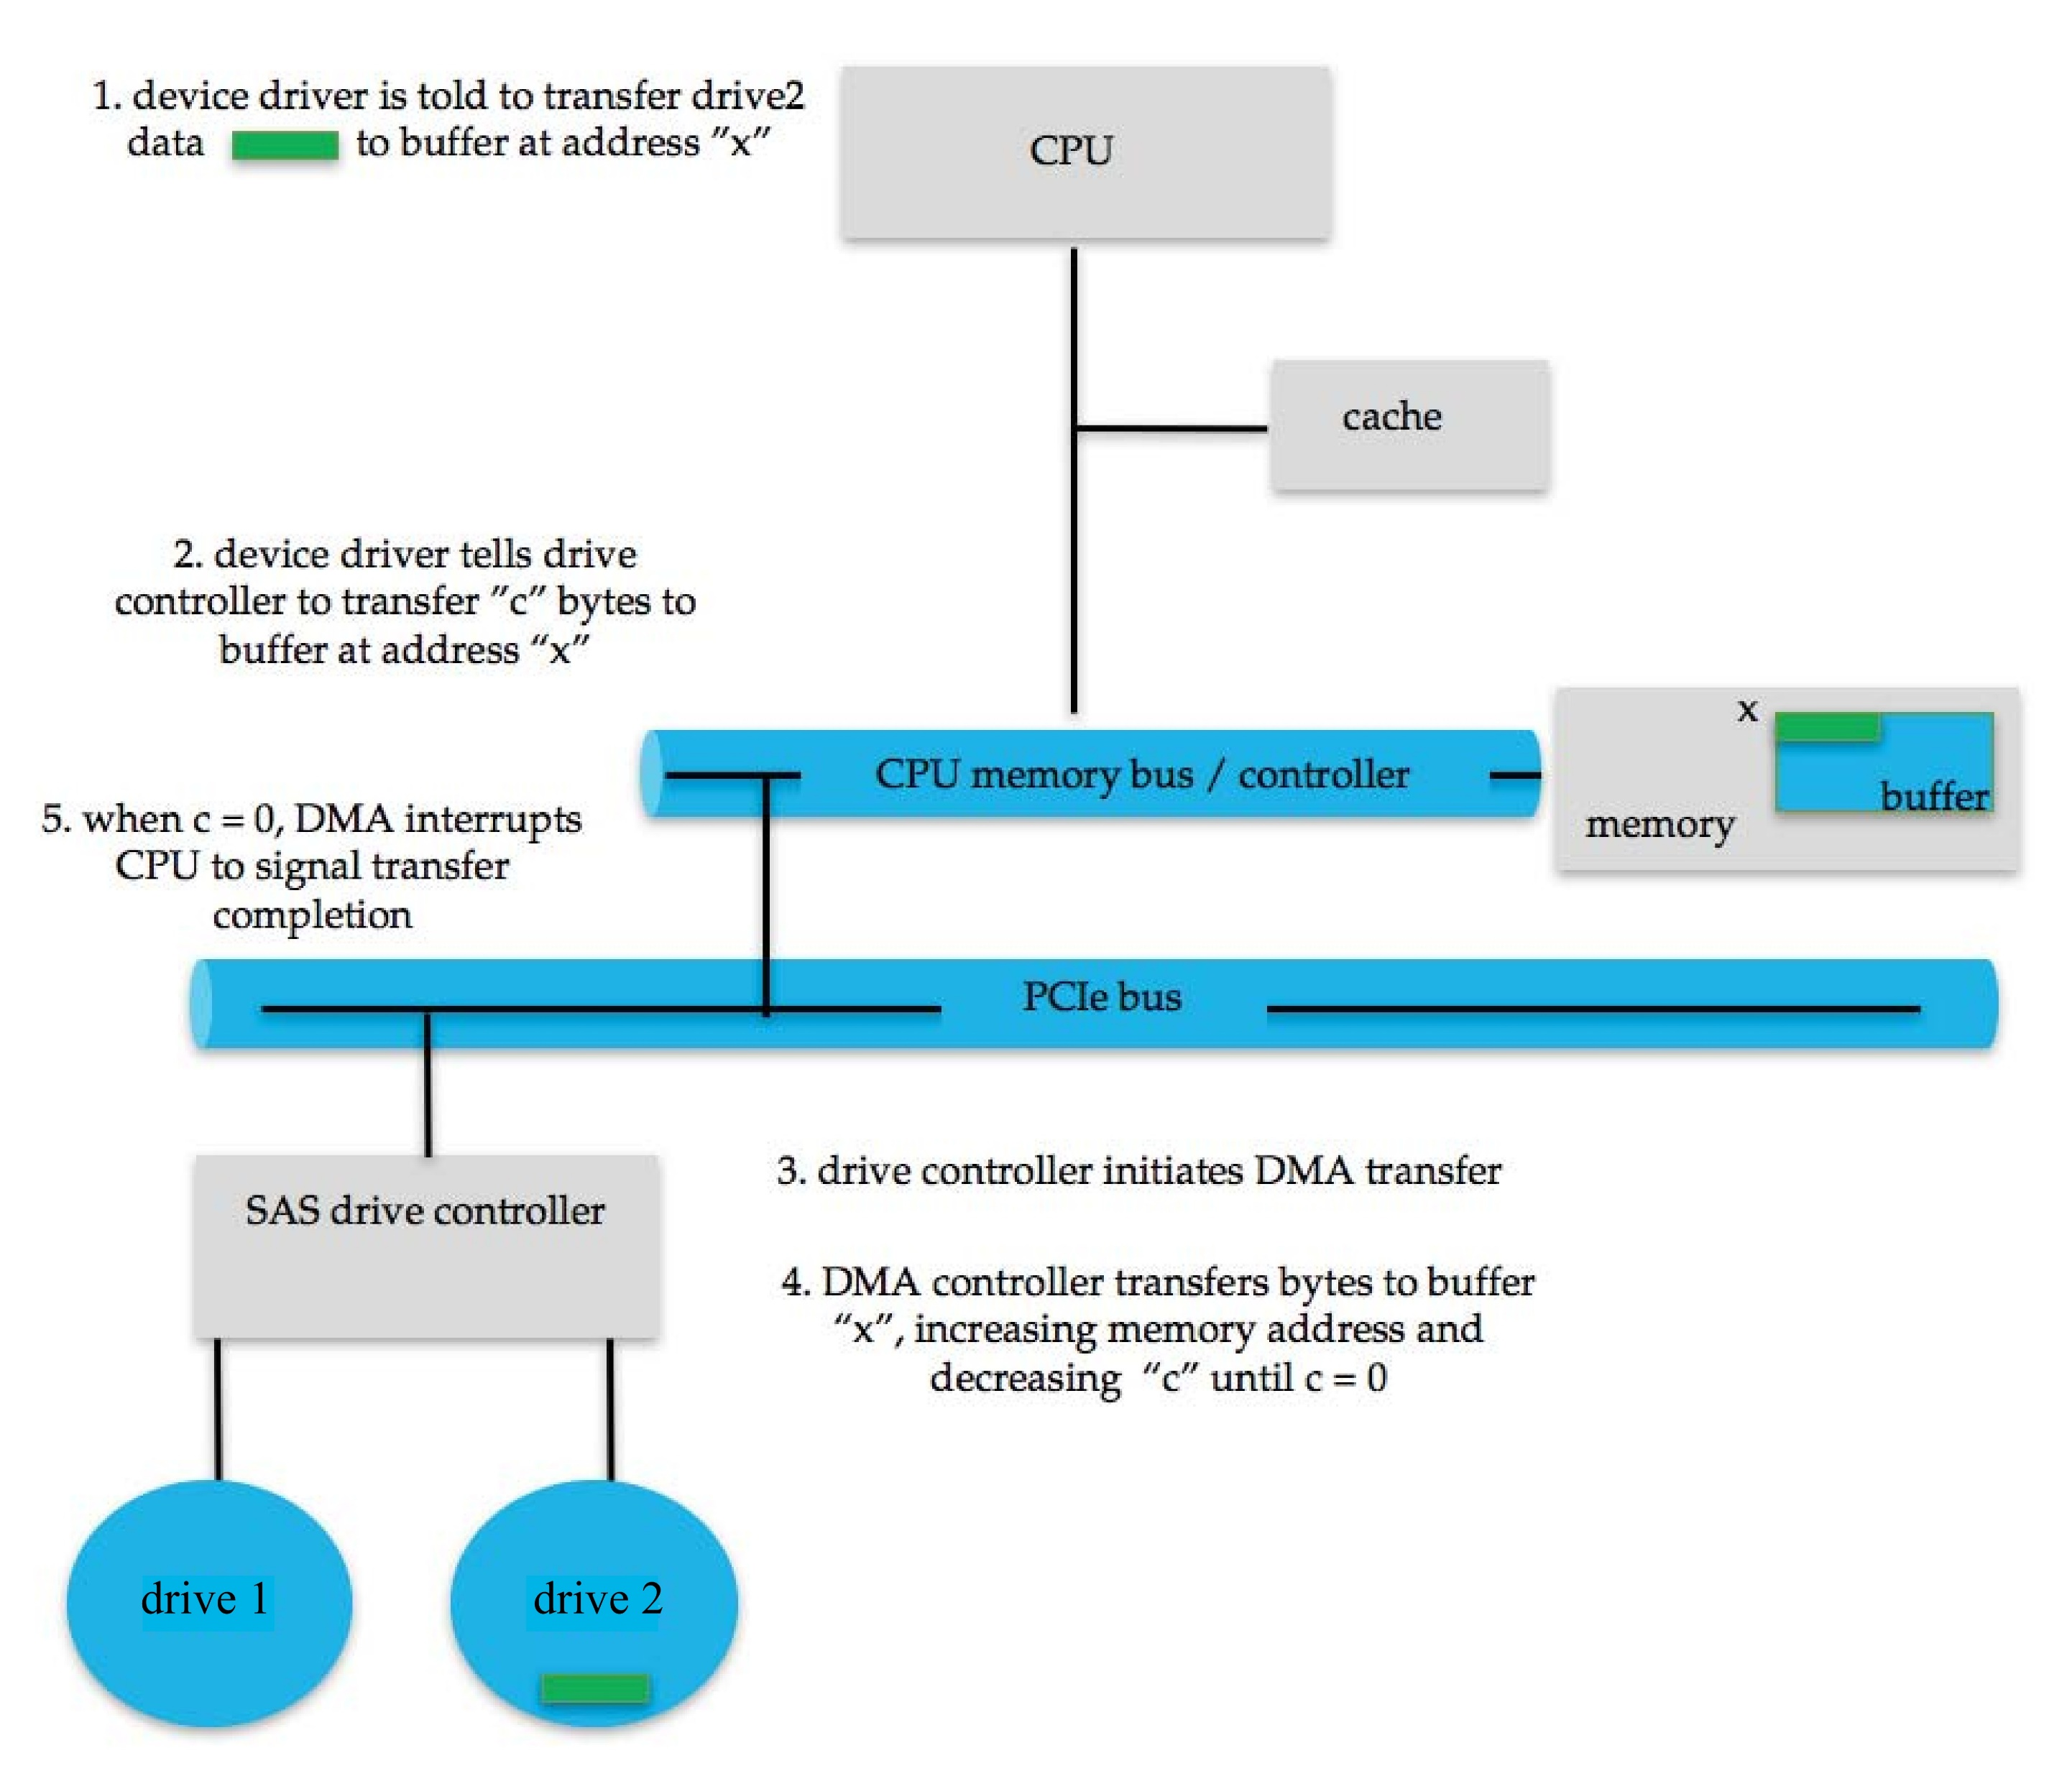
Six Step Process to Perform DMA Transfer

